Slide 1
Level 4/5 Group 18
Blake Hewitt, Elliot Dewhurst & Guy Zawada

Slide 2
What’s Our Idea?
Physics-Based, Sumo style, 1 on 1 arena game
The objective is to push your opponent off the arena
Collect Power Ups to increases you pushing force and other attributes

Slide 3
Mechanics
Physics based pushing
Power Up collection
Avoidance of opponent and obstacles
Round Timer

Slide 4
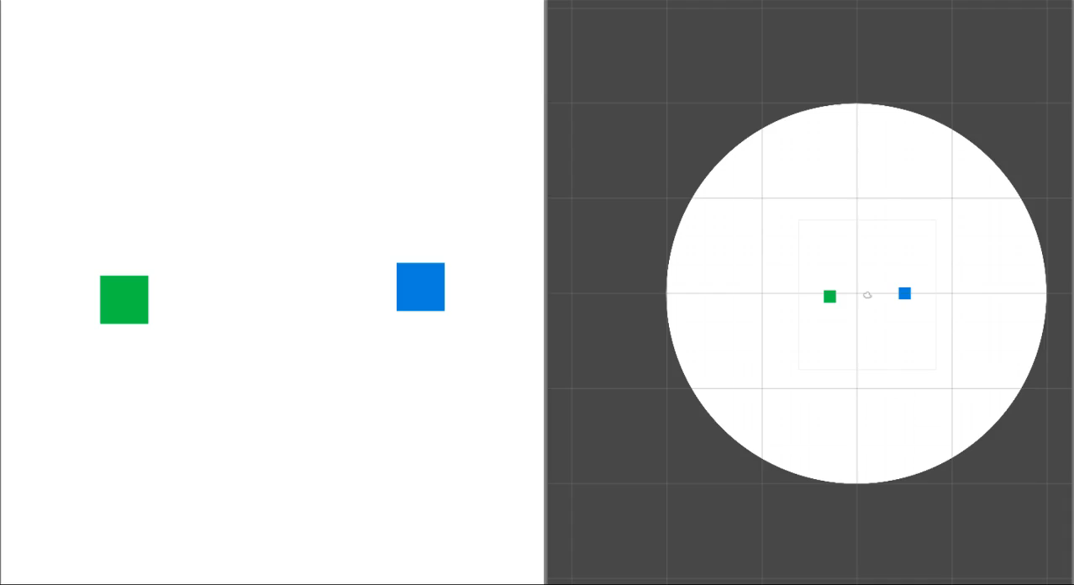
Gameplay Demo

Slide 5
Design
Simple art style
2 Player competition
Single life per round

Slide 6
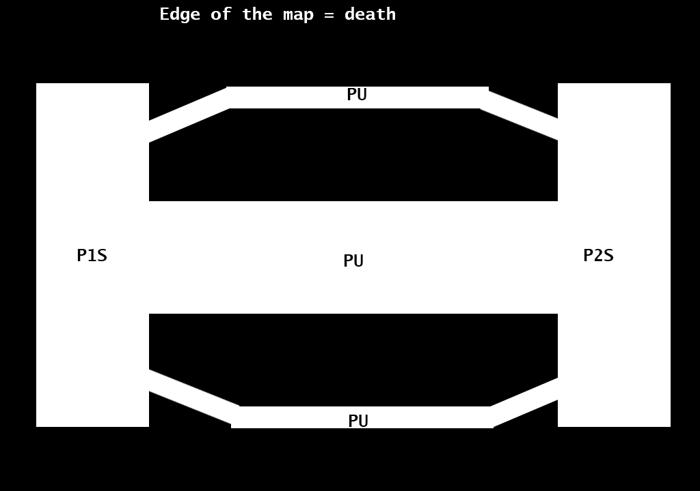
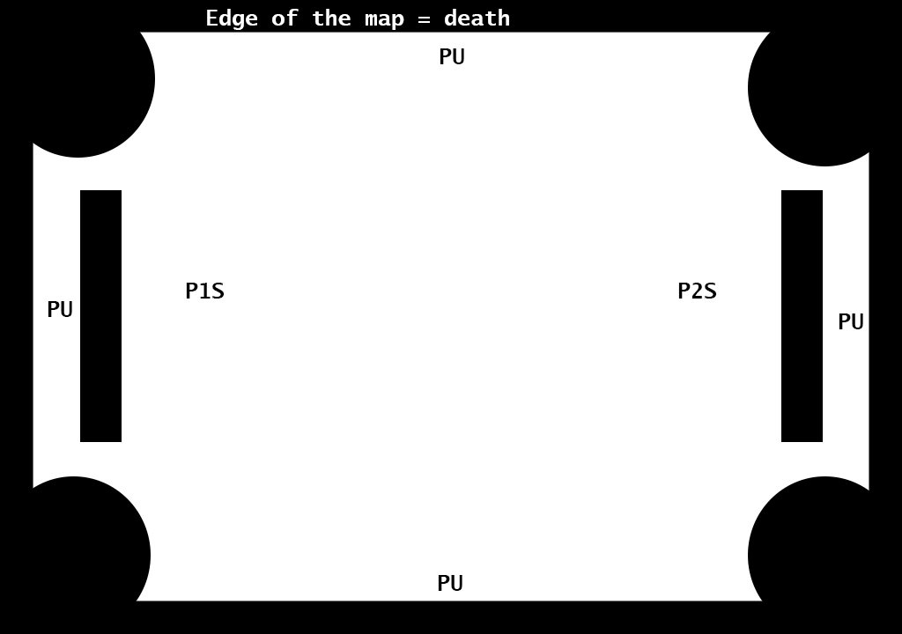
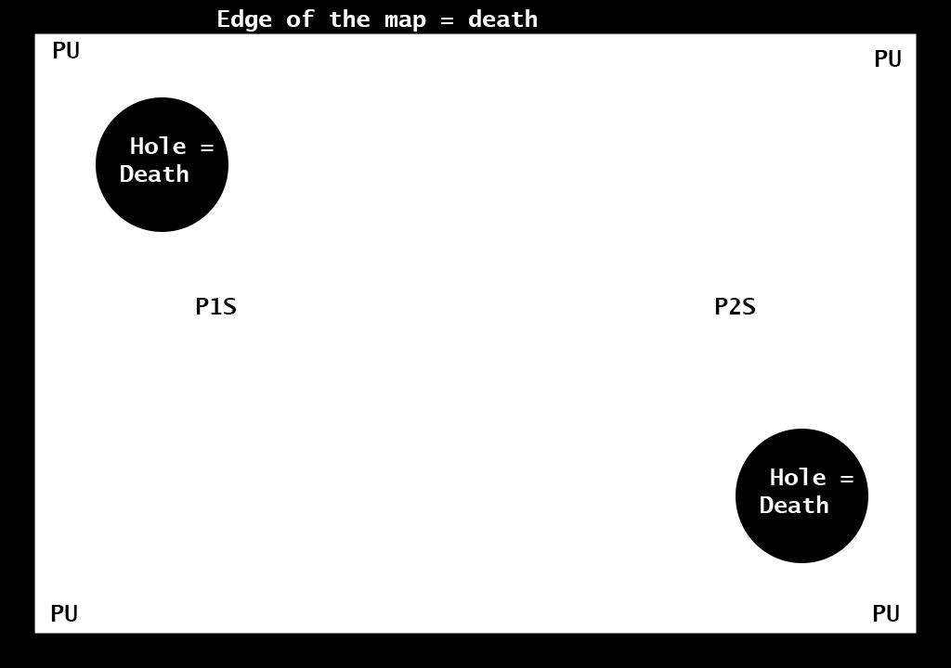
Level Designs

Slide 7
Level Design Details
Power Ups – Increase Mass, Increase Pushing Force, Increase Speed
Obstacles in the level
Random level for each round

Slide 8
UI/Screen Mock Up

Slide 9
Stretch/Future Goals
Shrinking Level
Different Floors to levels
Fully decide the art style

Slide 10
Questions?

